Slide 1
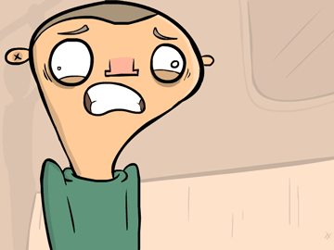
COPD
Puja Trivedi
Highly Specialist Physiotherapist
Harefield Hospital

Slide 2

Learning Outcomes
Understand the pathophysiology of COPD
Recognise common signs and symptoms of COPD
Be able to classify severity of COPD
Understand the different types of respiratory failure
Select appropriate treatment strategies for stable COPD

Slide 3

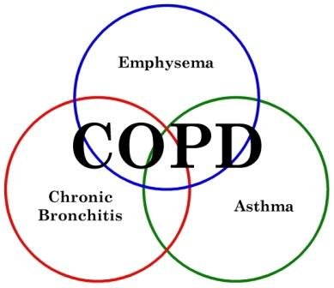
Definition of COPD
A disease state characterised by airflow obstruction resulting from chronic bronchitis or emphysema
Airway obstruction is progressive
Airway obstruction is only partially reversible and does not change markedly over several months

Slide 4

Epidemiology of COPD
Globally around 3 million deaths annually due to COPD
Expected increase to 5.4 million by 2060
Huge financial burden on the NHS
Respiratory disease accounts for approximately 6% of the total healthcare budget
COPD accounts for 56% of this!
(Gold, 2023)
Notes:
Relationship between severity of COPD and cost – cost mainly due to exacerbations, hospitalisations and oxygen

Slide 5

Chronic Bronchitis
Defined as a persistent cough with sputum production for at least 3 months of the year for 2 consecutive years
Disease of the medium and large sized airways – the bronchioles
Insidious onset with a morning cough – smoker’s cough

Slide 6
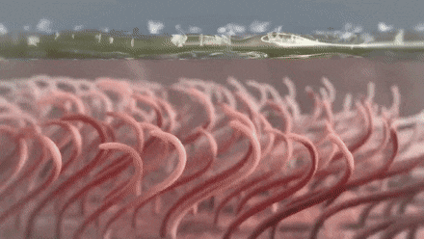
Chronic Bronchitis
Repeated inhalation of pollutants leads to irritation of the airway mucosa
Hyperplasia and hypertrophy of mucus glands in the large airways
Excessive amounts of mucus in the airways
Hyperplasia of goblet cells occurs at the expense epithelial cells
Reduced ciliary function
Small airways become obstructed by mucus
Bacterial colonisation and repeated infection

Slide 7
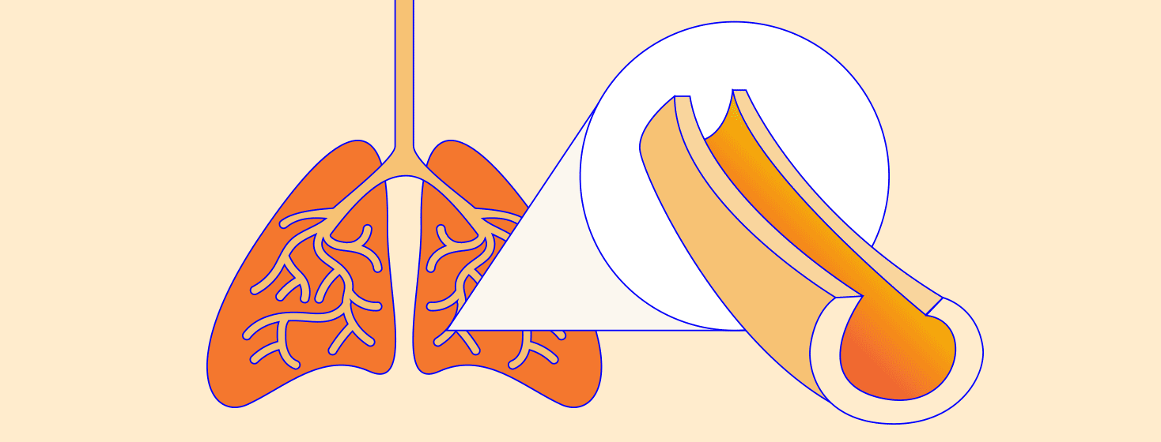
Chronic Bronchitis
Small airways become narrowed due to inflammatory changes – airway remodelling
Mucosal oedema
Smooth muscle hypertrophy
Peribronchial fibrosis

Slide 8
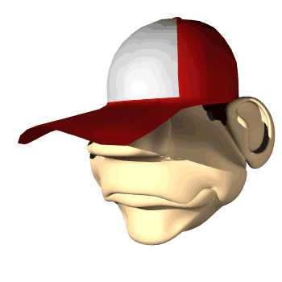
Chronic Bronchitis
Secondary effects of chronic bronchitis
Airway obstruction
Increased resistance to airflow
V/Q mismatch – to be discussed in more detail in next session!
Impaired gas exchange
Increased work of breathing

Slide 9

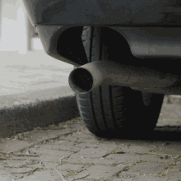
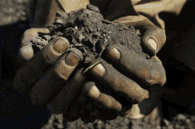
Aetiology of Chronic Bronchitis

Slide 10
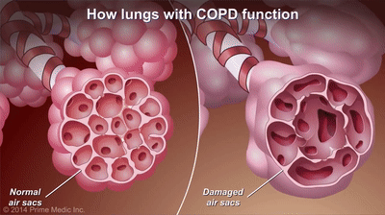
Emphysema
Primarily a disease of the alveoli
Protein breakdown
Erosion of alveola septa
Destruction of elastic fibres
Destruction of capillary bed
Airways become floppy
Formation of bullae
Permanent enlargement of the airspaces distal to the terminal bronchioles
Notes:
How many alveoli are there in the lungs? Tennis court surface area

Slide 11
Secondary effects of emphysematous changes
Airflow obstruction
Increased resistance to airflow
Reduced surface area for gas exchange
V/Q mismatch
Increased work of breathing

Slide 12
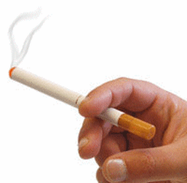
Aetiology of Emphysema
Alpha 1 antitrypsin deficiency
Genetic cause
Alpha 1 anti-trypsin inhibits the action of neutrophil elastase which destroys elastin
Develops before the age of 40
Equal distribution between sexes
SMOKING is the major cause

Slide 13

IMPORTANT
Chronic Bronchitis and Emphysema may well co-exist

Slide 14
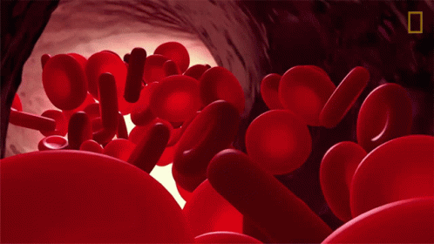
Further secondary effects of COPD
Cor Pulmonale
Right ventricular failure
To discuss further later!
Polycythaemia
Bodies response to chronic hypoxia
Increase in total volume of red blood cells
Increased blood viscosity

Slide 15

Clinical features of COPD
Subjective examination
Productive cough
Wheeze
Shortness of breath
Decreased exercise tolerance/functional ability
Recurrent chest infections

Slide 16

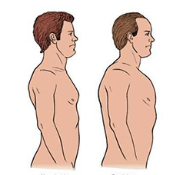
Clinical features of COPD
Objective examination
Auscultation: wheeze, decreased breath sounds, crackles
Hyperinflated chest: Increased AP diameter - barrel chest
Productive cough – purulent sputum

Slide 17
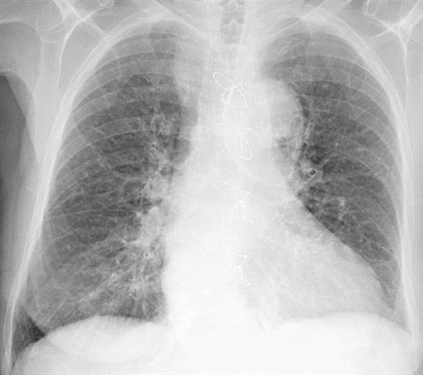
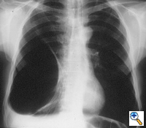

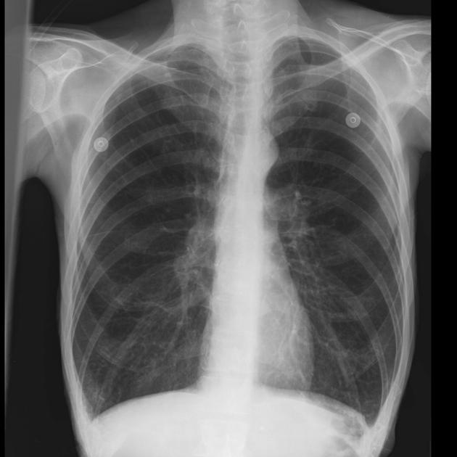
Chest X-ray
Emphysema
Hyperinflated
Long thin heart
Black lung fields
Chronic Bronchitis
Patchy shadowing
Increased cardiac shadow

Slide 18
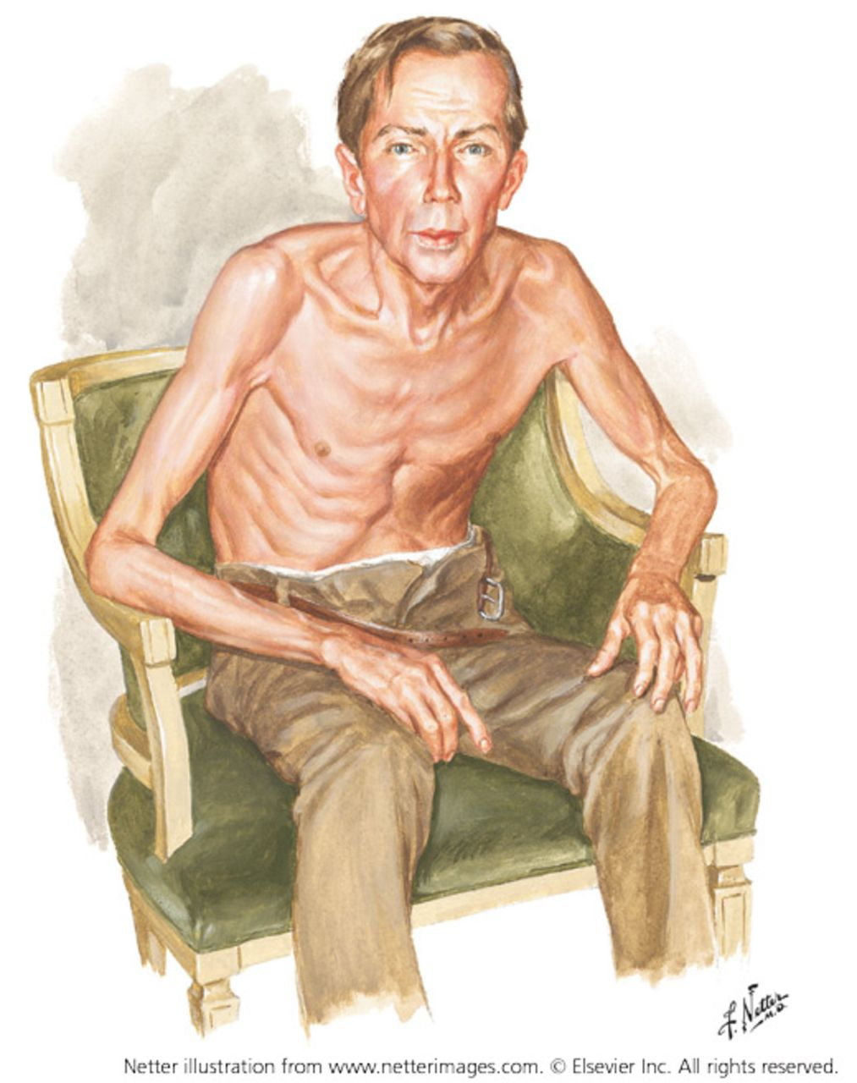
Signs of Respiratory Distress in COPD
Pursed lip breathing
Prolonged expiration
Increased RR
Cyanosis
Active expiration
Fixing of upper limbs
Use and hypertrophy of accessory muscles
Soft tissue recession
Hoover’s sign

Slide 19

Respiratory Failure
The inability to maintain partial pressures in arterial blood of carbon dioxide (PaCO₂) and oxygen (PaO₂) within normal physiological limits
PaO₂ < 8kPa
PaCO₂ > 6.5 kPa

Slide 20
Type 1 Respiratory Failure
Decreased PaO₂
Normal or low PaCO₂
Treated with supplementary oxygen

Slide 21
Type 2 Respiratory Failure
Decreased PaO₂
Increased PaCO₂
Alveola hypoventilation
Can be acute or chronic

Slide 22
Acute Type 2 Respiratory Failure
Decreased PaO₂
Increased PaCO₂
Normal HCO₃⁻
Kidneys take 2-3 days to compensate for raised PaCO₂
Decreased pH – respiratory acidosis

Slide 23
Chronic Type 2 Respiratory Failure
Decreased PaO₂
Increased PaCO₂
Raised HCO₃⁻
Kidneys have now compensated
Normal pH
Example - COPD

Slide 24
Acute on Chronic Type 2 Respiratory Failure
Decreased PaO₂
Increased PaCO₂
Raised HCO₃⁻
Decreased pH – acidotic
PaCO₂ normally high but due to sudden deterioration has risen further so kidneys no longer able to compensate
E.g. acute exacerbation of COPD

Slide 25
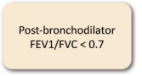

Classification of COPD
EXACERBATION
HISTORY
Spirometric Stage
≥ 2 moderate exacerbations or ≥1 leading to hospitalisation
E
Grade | FEV₁ (% predicted)
GOLD 1 | ≥ 80
GOLD 2 | 50-79
GOLD 3 | 30-49
GOLD 4 | < 30
0 or 1 moderate exacerbations (not leading to hospitalisation
A
B
SYMPTOMS
(Gold, 2022)

Slide 26
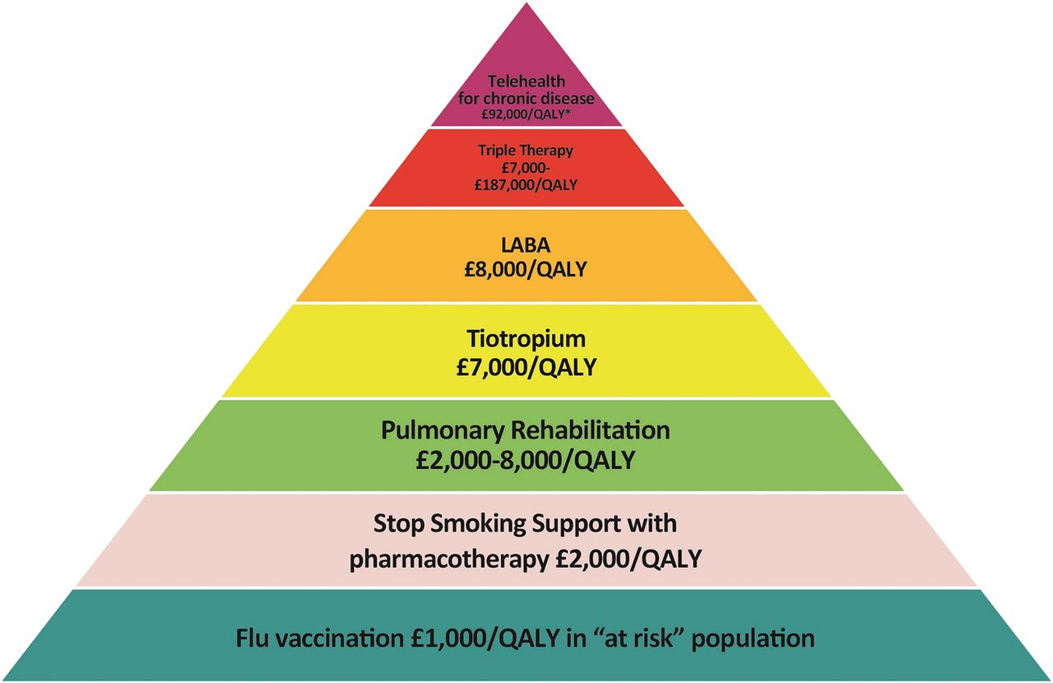
Management of stable COPD

Slide 27

Inhaled Therapy
EXACERBATION
HISTORY
≥ 2 moderate exacerbations or ≥1 leading to hospitalisation
Group E
LABA + LAMA
Consider LABA + LAMA + ICS if blood eos ≥ 300
0 or 1 moderate exacerbations (not leading to hospitalisation
Group A
Bronchodilator
Group B
LABA + LAMA
SYMPTOMS
(Gold, 2022)

Slide 28
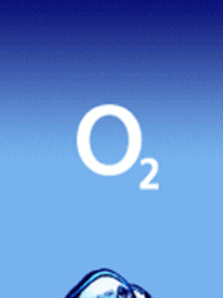
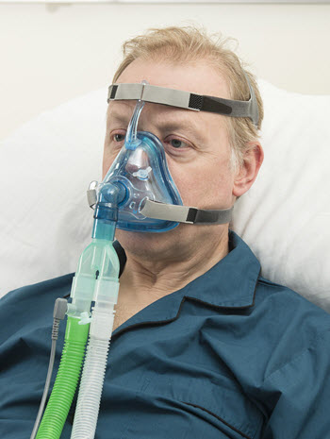

Further management
Long term oxygen therapy
Assessment ideally carried out in a stable state
2 assessments required minimum of 3 weeks apart (if hypoxic during first appointment)
To use for a minimum of 15HPD
Non invasive ventilation
T2RF
Surgery
Endobronchial valves
Coils
Thermal ablation
Lung volume reduction surgery
Lung transplant

Slide 29

Physiotherapy Management
Education
Breathlessness management – practical next week!
Airway clearance techniques
Pulmonary Rehabilitation

Slide 30
Management of acute exacerbations of COPD
Practical on the 13/12/2022
ESSENTIAL pre-reading:
2023 GOLD Report - Global Initiative for Chronic Obstructive Lung Disease - GOLD (goldcopd.org) Chapter 5 pp.134-153
Recommendations | Chronic obstructive pulmonary disease in over 16s: diagnosis and management | Guidance | NICE – Section 1.3

Slide 31
References and further reading
2023 Gold Report - Global Initiative for Chronic Obstructive Lung Disease (2022) GOLD. Available at: https://goldcopd.org/2023-gold-report-2/# (Accessed: November 29, 2022).
Overview: Chronic obstructive pulmonary disease in over 16s: Diagnosis and management: Guidance (2018) NICE. Available at: https://www.nice.org.uk/guidance/ng115 (Accessed: November 29, 2022).

